Slide 1

Cricket Match Analysis: Decoding the Game Through Data
By
Sumanth Mittapally - 885157511
Rohit Yadla - 885146852

Slide 2

Problem Statement
Cricket, one of the most popular sports globally, generates vast amounts of data during matches, including player statistics, ball-by-ball details, weather conditions, and historical performance metrics. Analyzing this data comprehensively can provide valuable insights for teams, players, and enthusiasts. Traditional methods of cricket analysis often fall short in handling the sheer volume and complexity of this data. Therefore, the need arises for a robust and scalable cricket match analysis platform leveraging big data technologies.

Slide 3
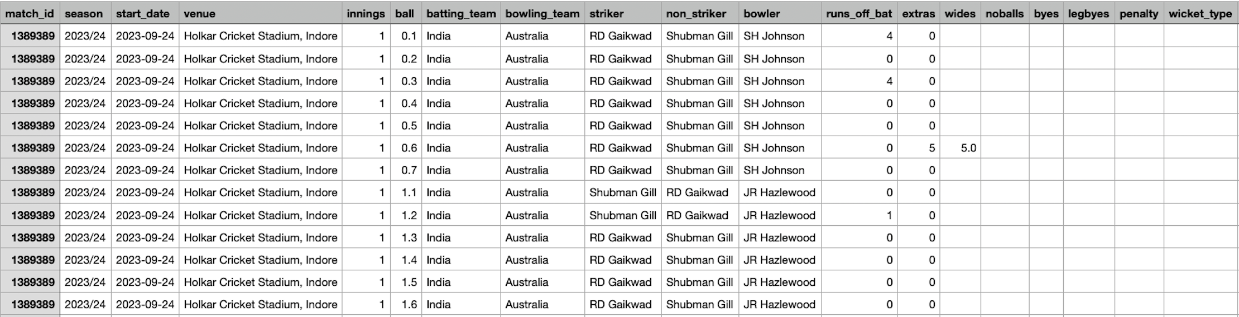
Data Set
ODI Match_Data

Slide 4
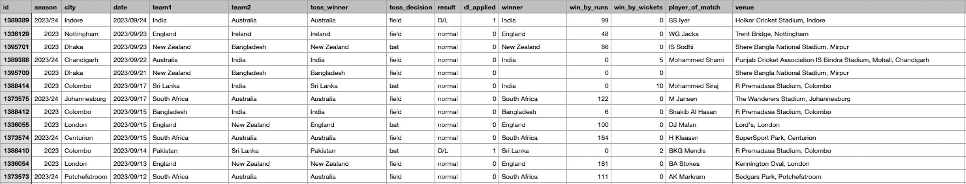
Data Set
ODI Match_Info

Slide 5

Approach
Google Cloud Platform to implement the project
Implemented the spark project in cloud Dataproc
Pre-processing and querying Data using PySpark
Data Analysis and Data Visualization

Slide 6
Tools and Technologies
Hadoop Distributed File System (HDFS)
Google Cloud Dataproc
Google Cloud Platform(GCP)
PySpark
Jupyter Notebook

Slide 7
DEVELOPMENT FLOW
Dataproc Cluster Setup
Starting a Spark session
Data Cleaning
Data Analysis
Data Visualization

Slide 8
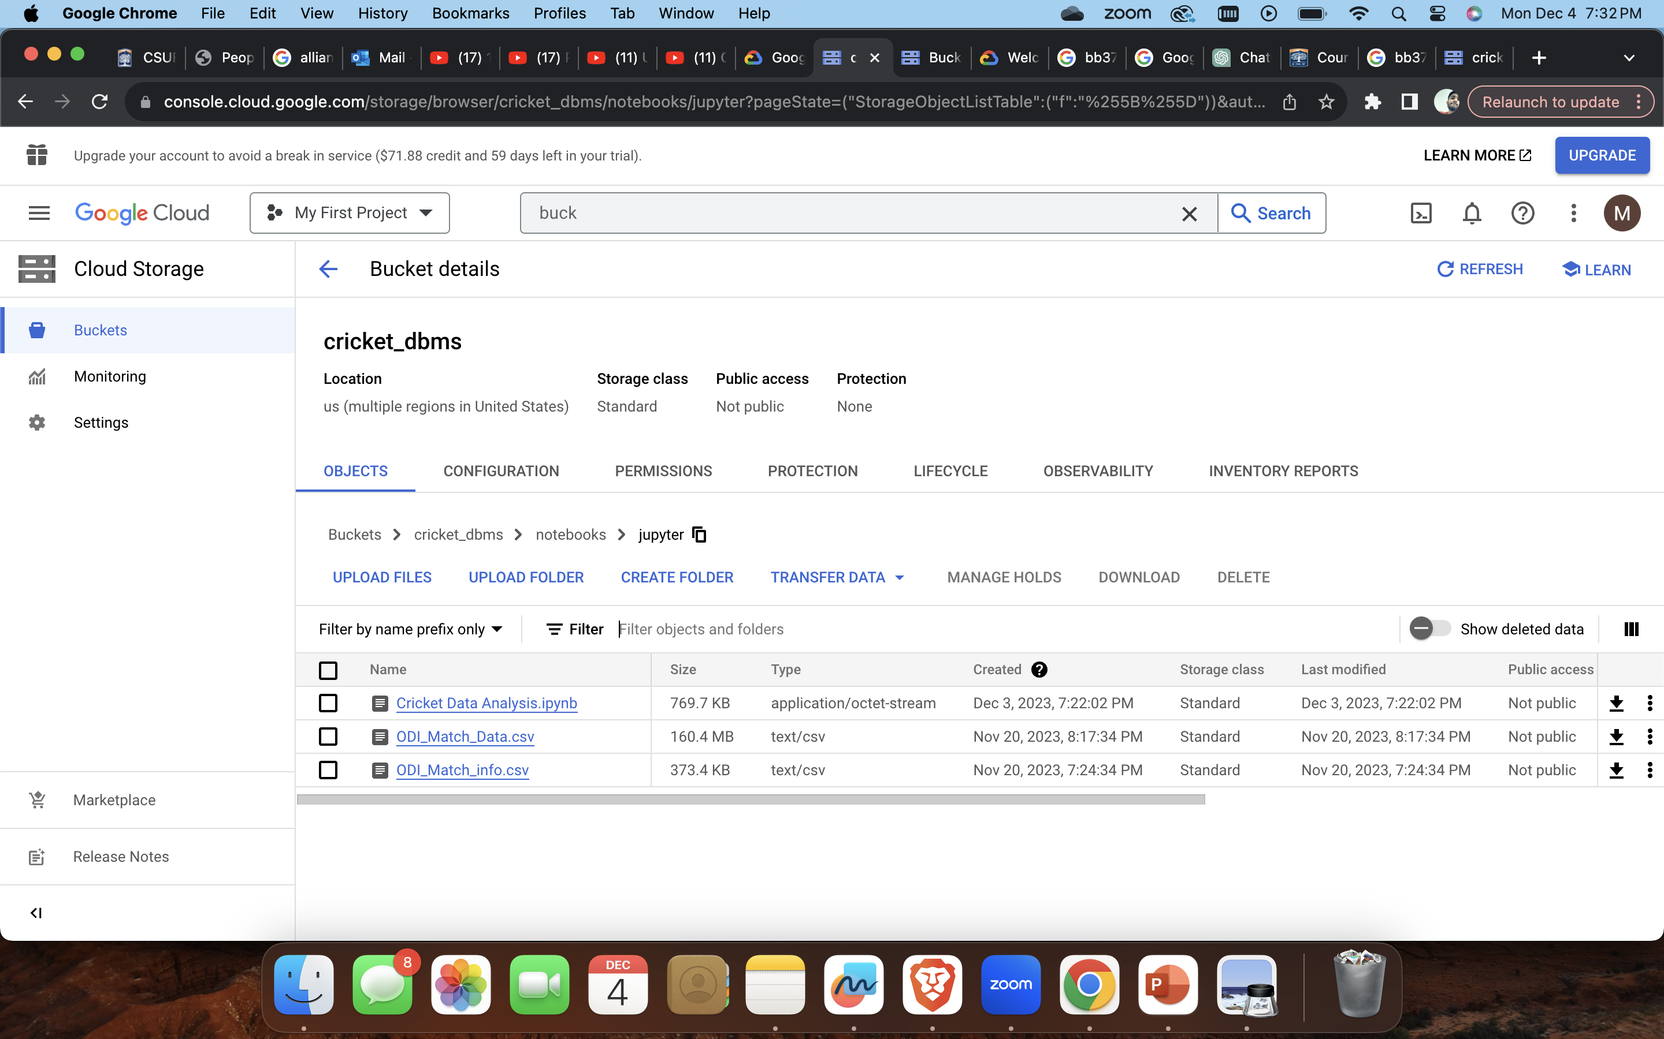
Bucket Storage

Slide 9
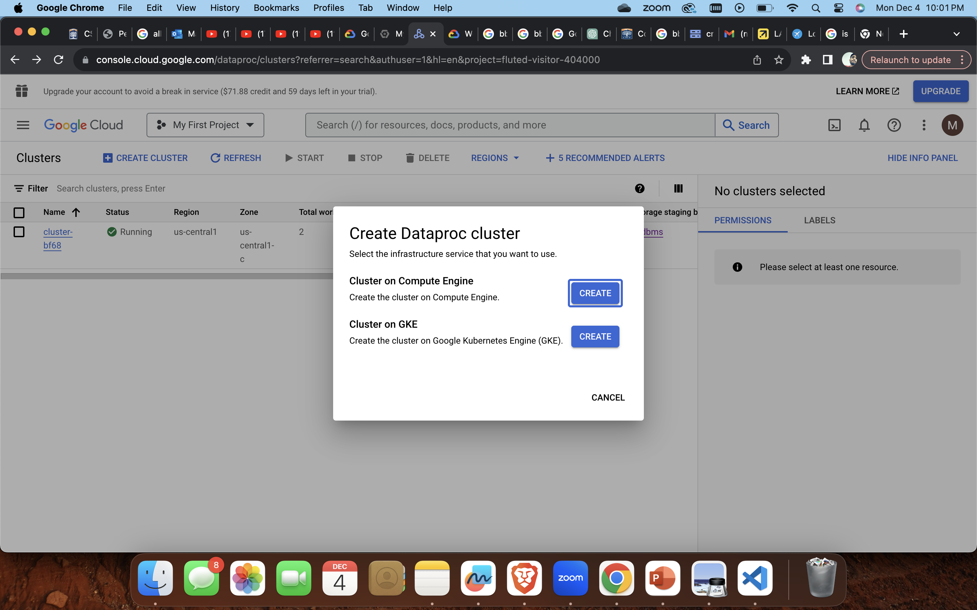
DatAPROc CLUSTER

Slide 10
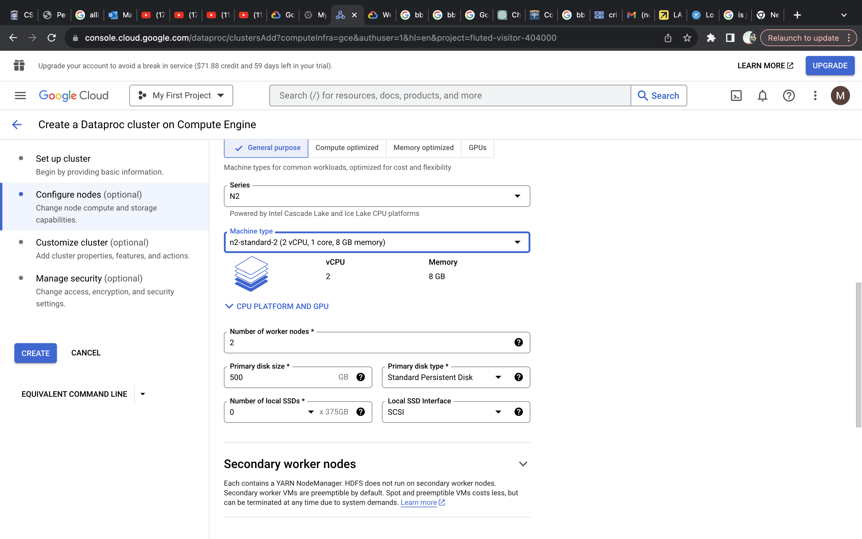
DatAPROC CLUSTER

Slide 11
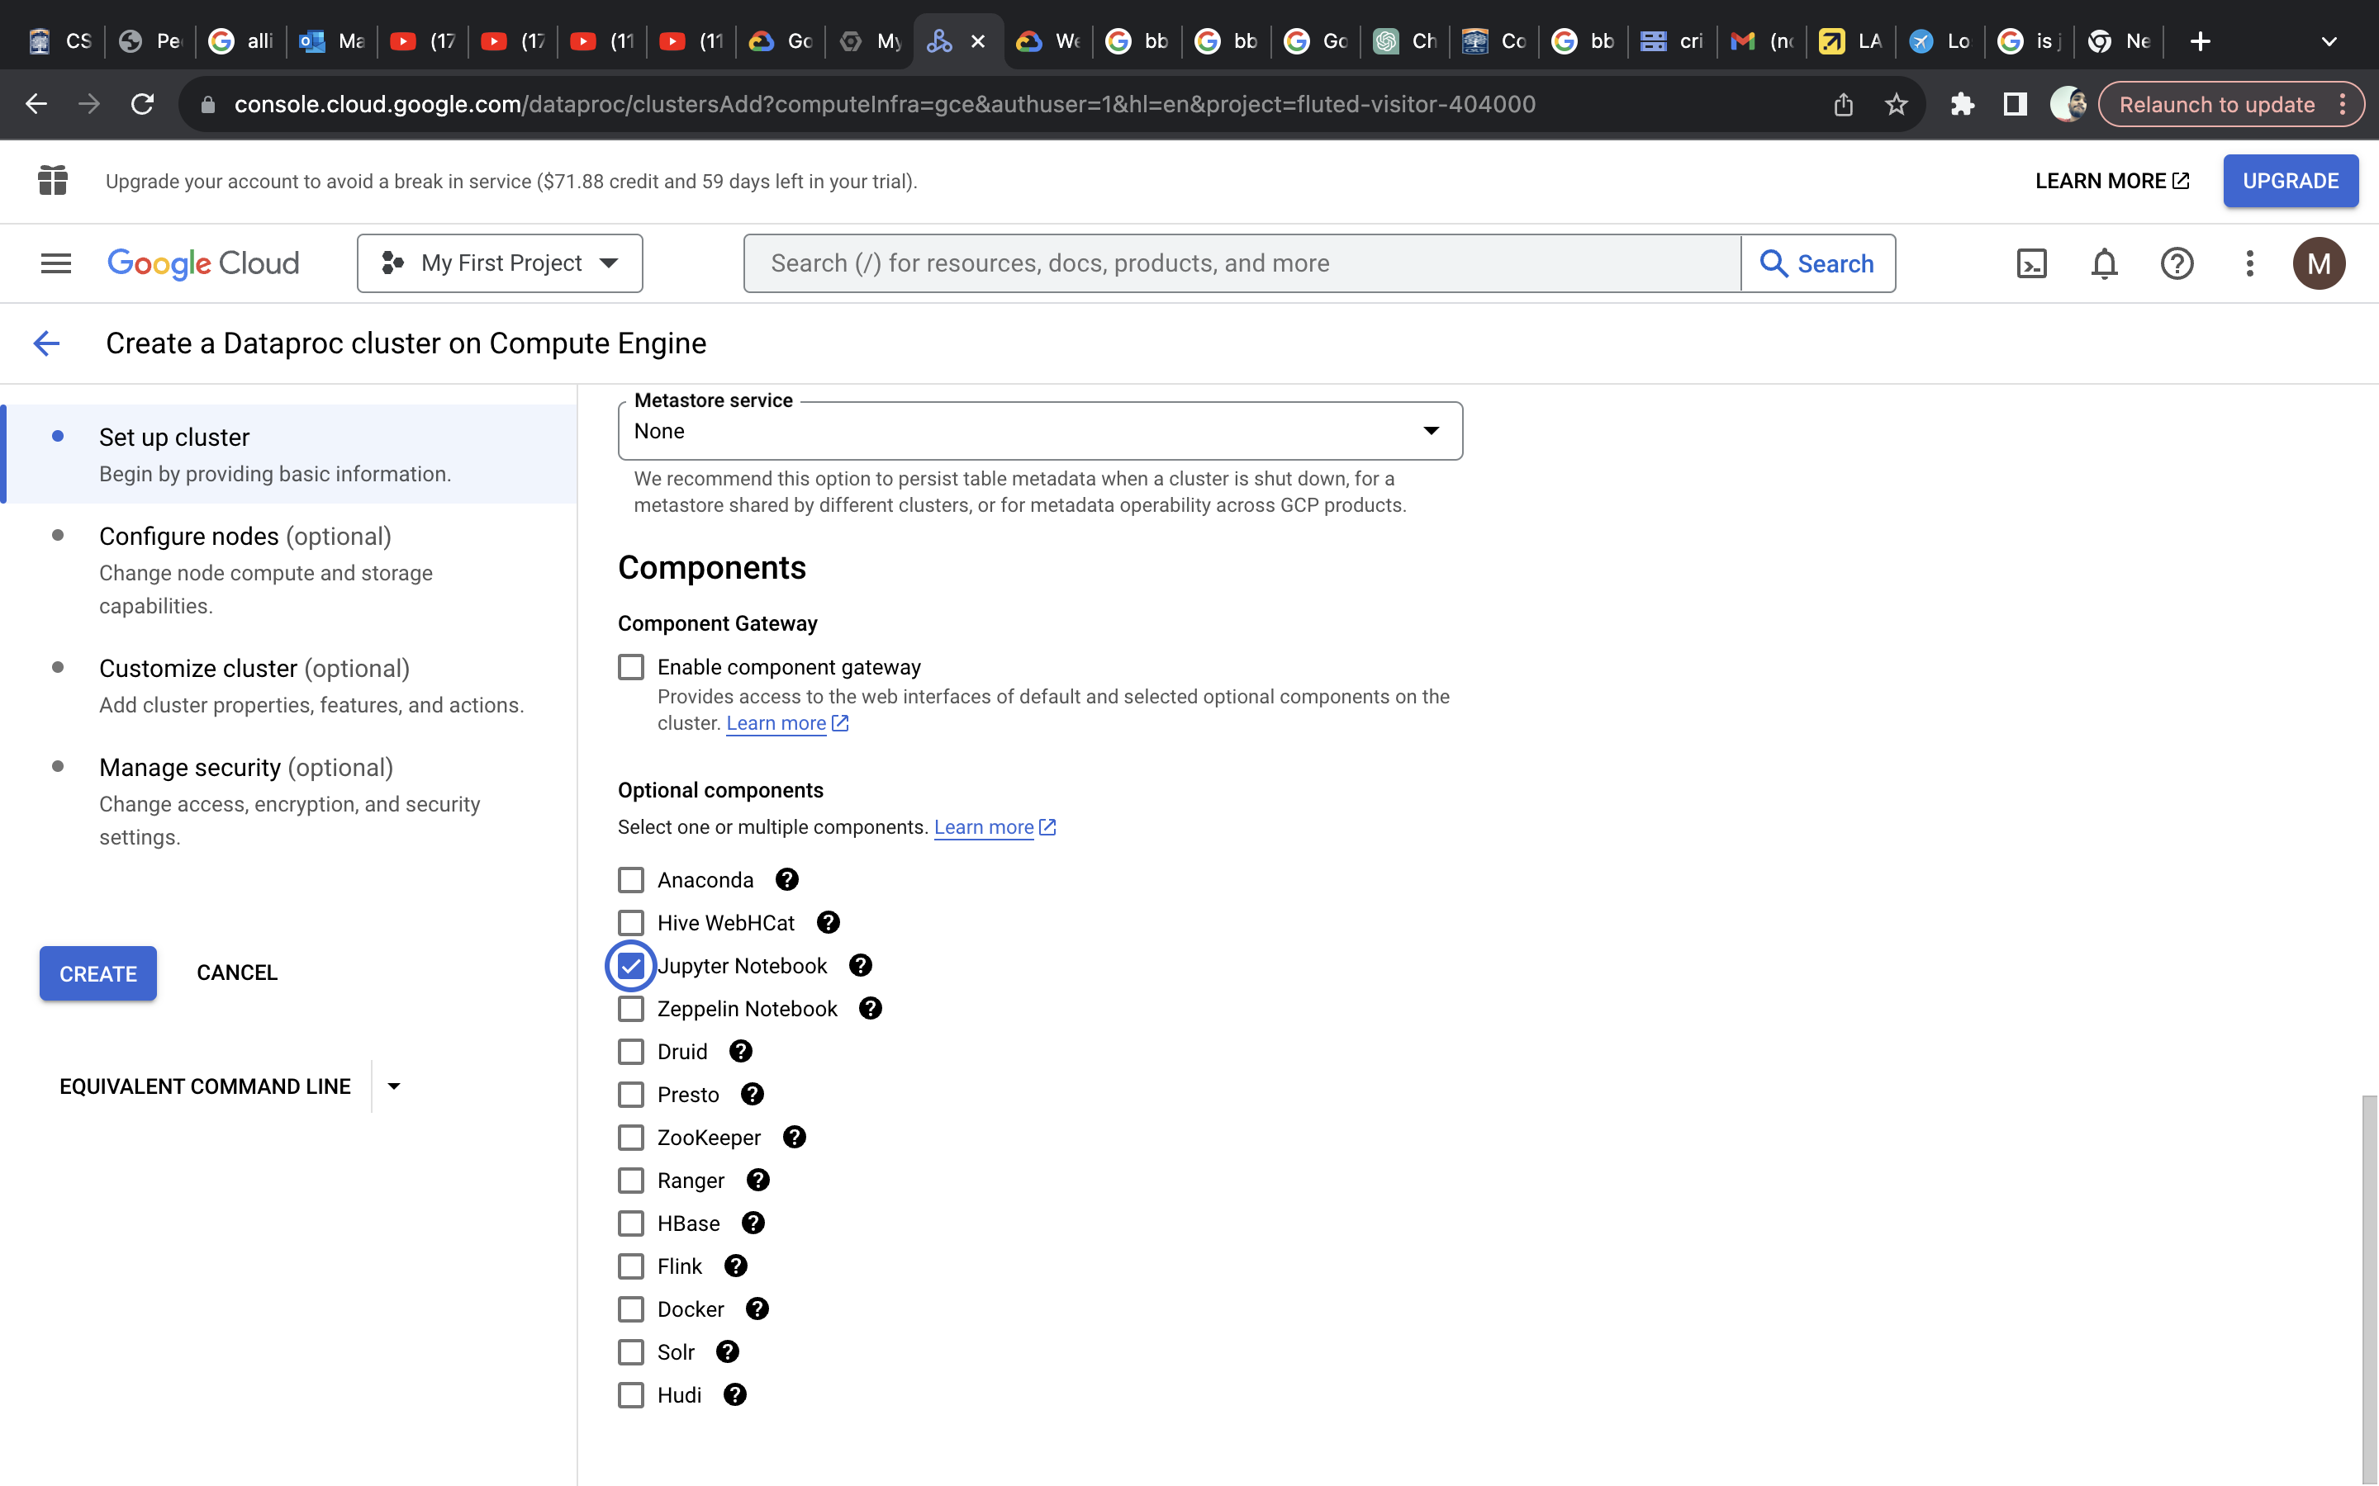
DatAPROC CLUSTER

Slide 12
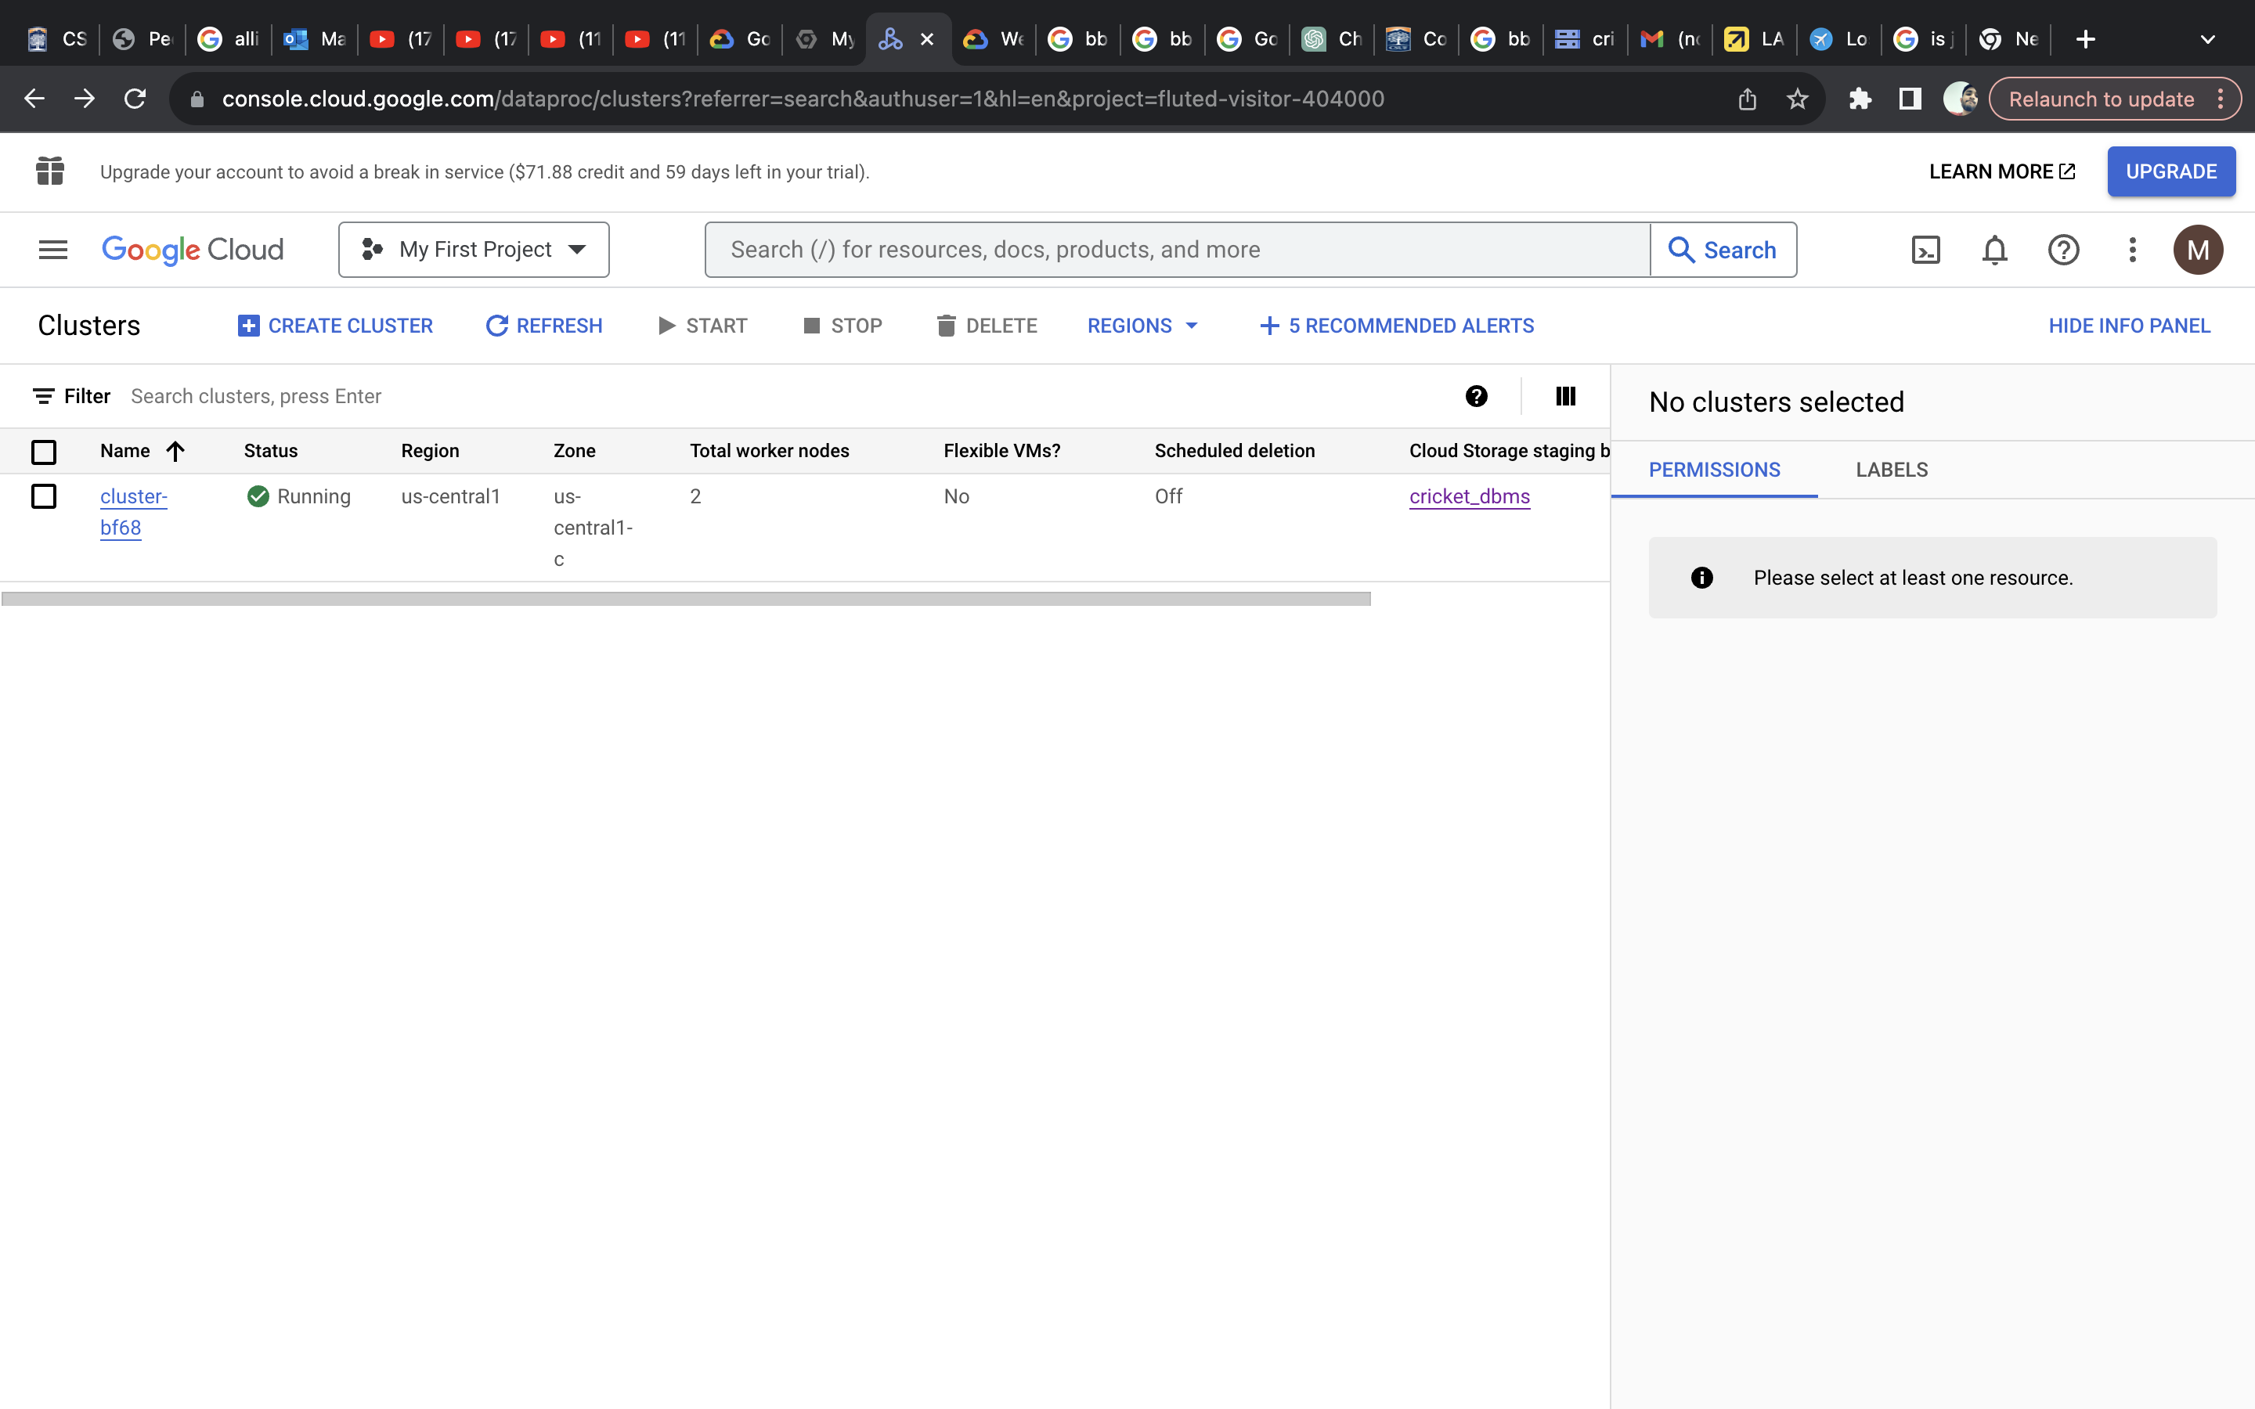
DatAPROC CLUSTER

Slide 13
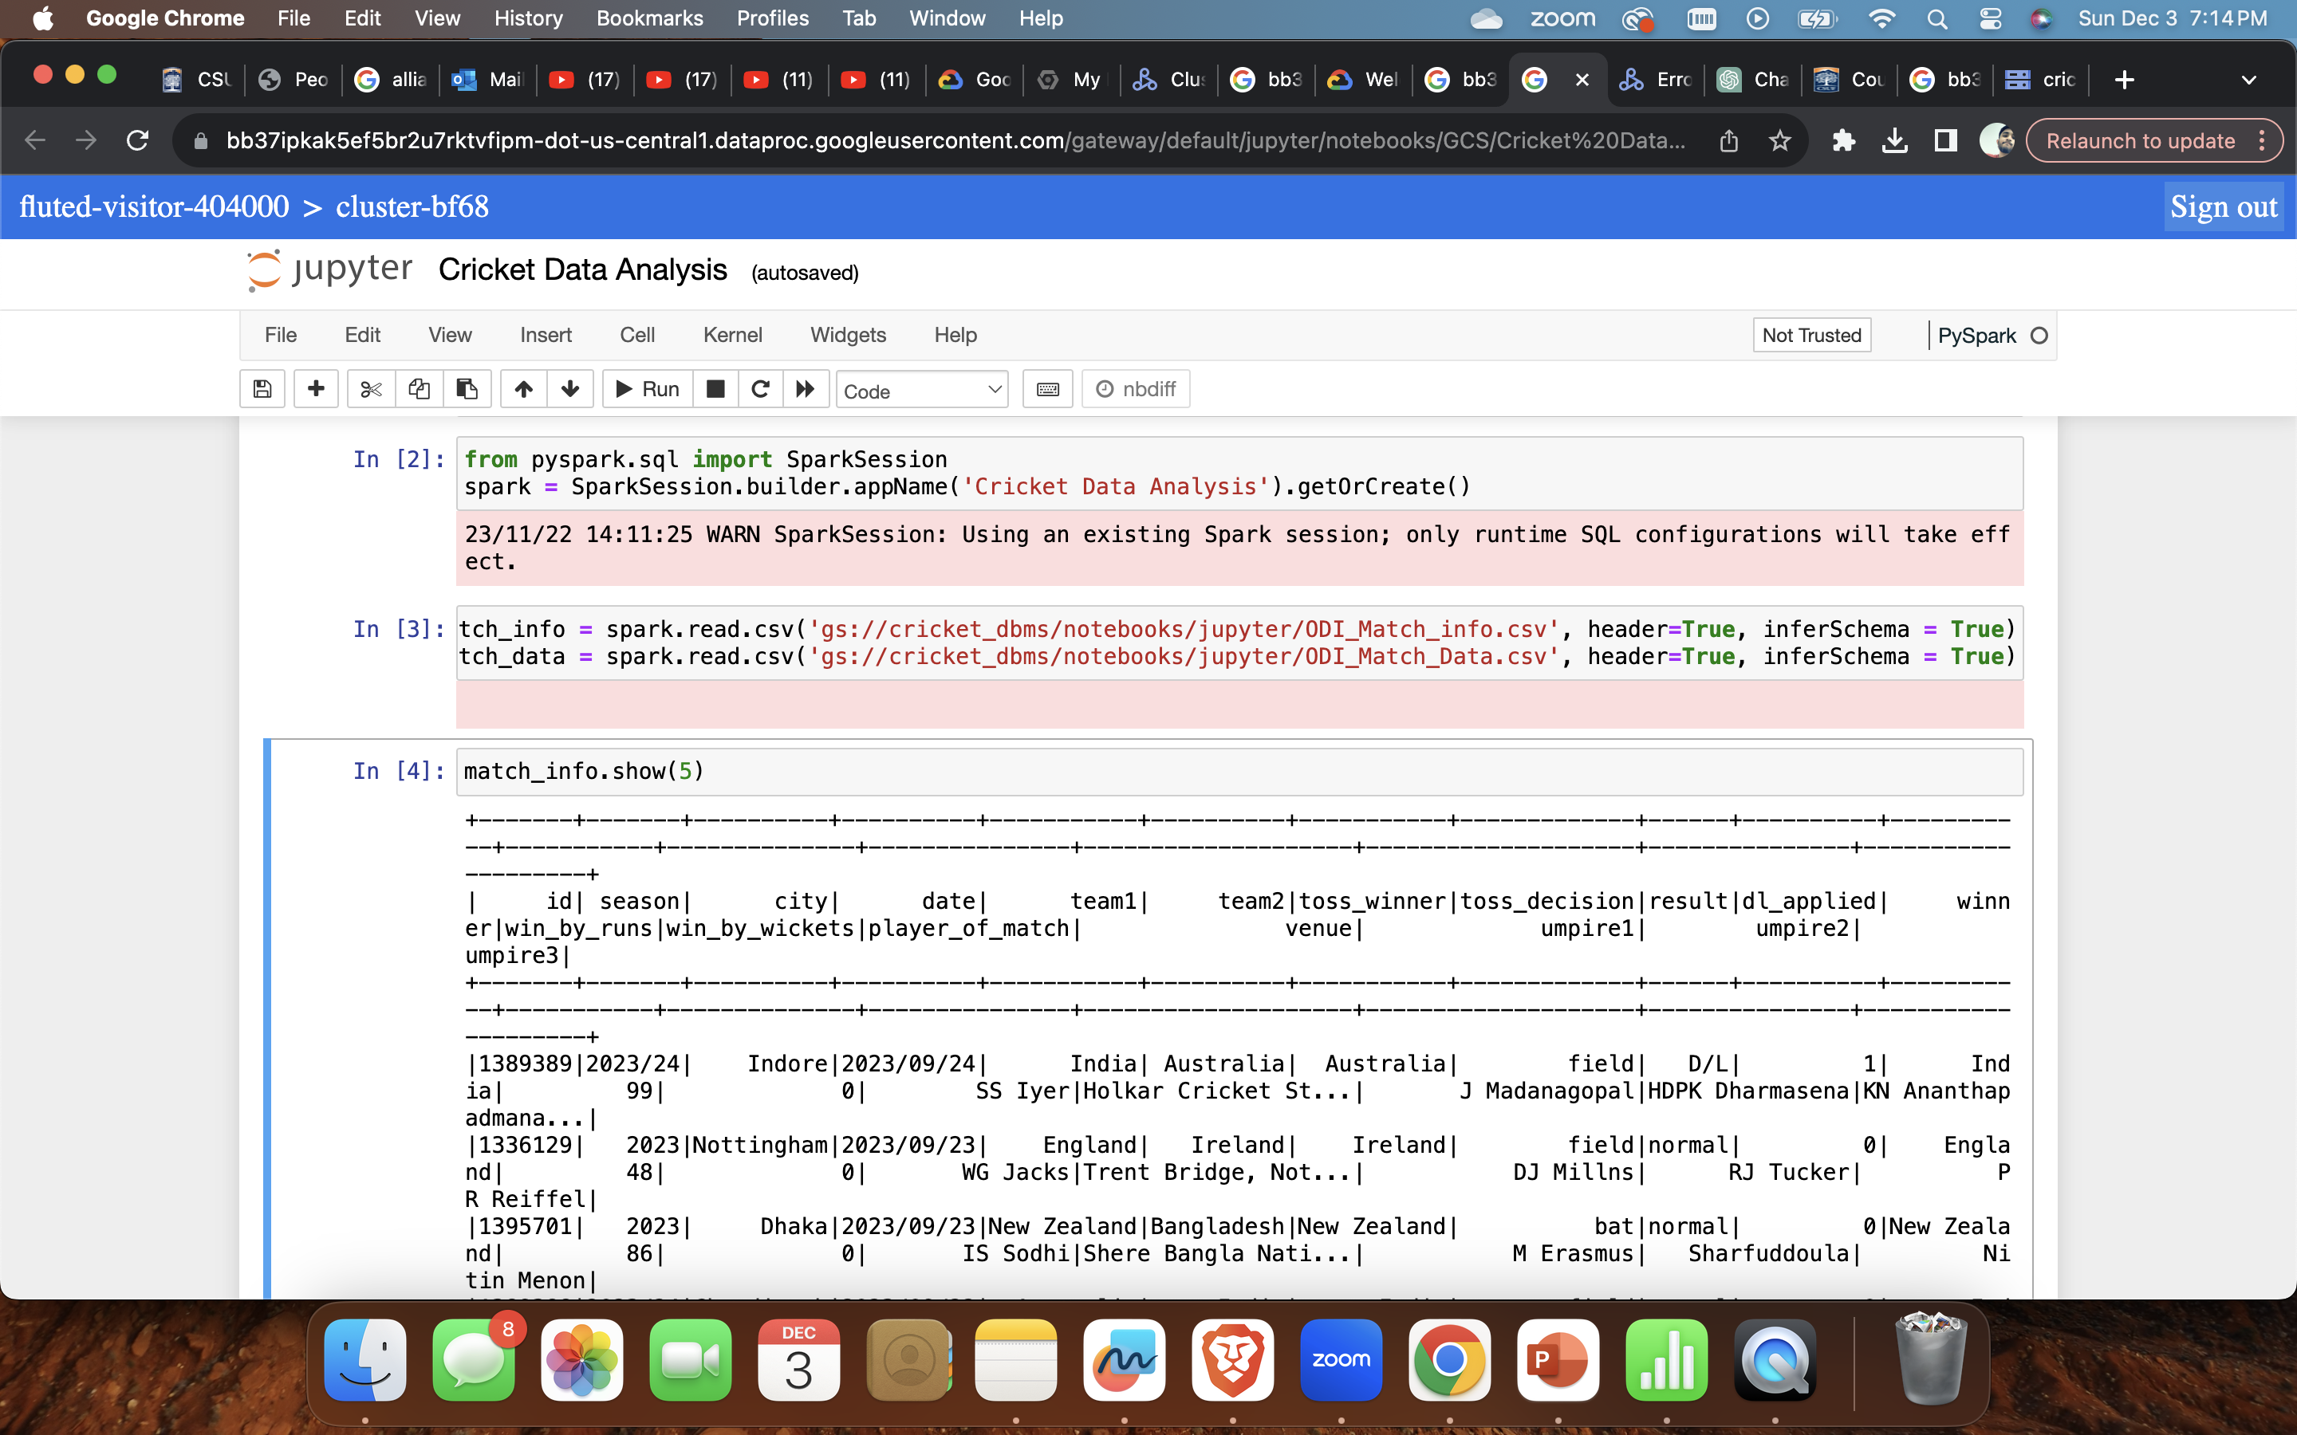
SPARK SESSION

Slide 14
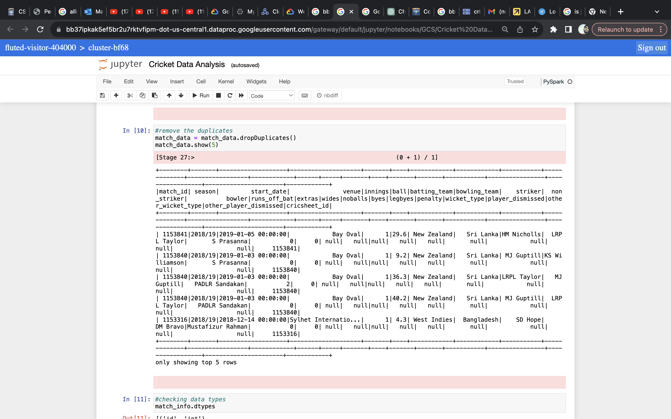
DATA CLEANING

Slide 15
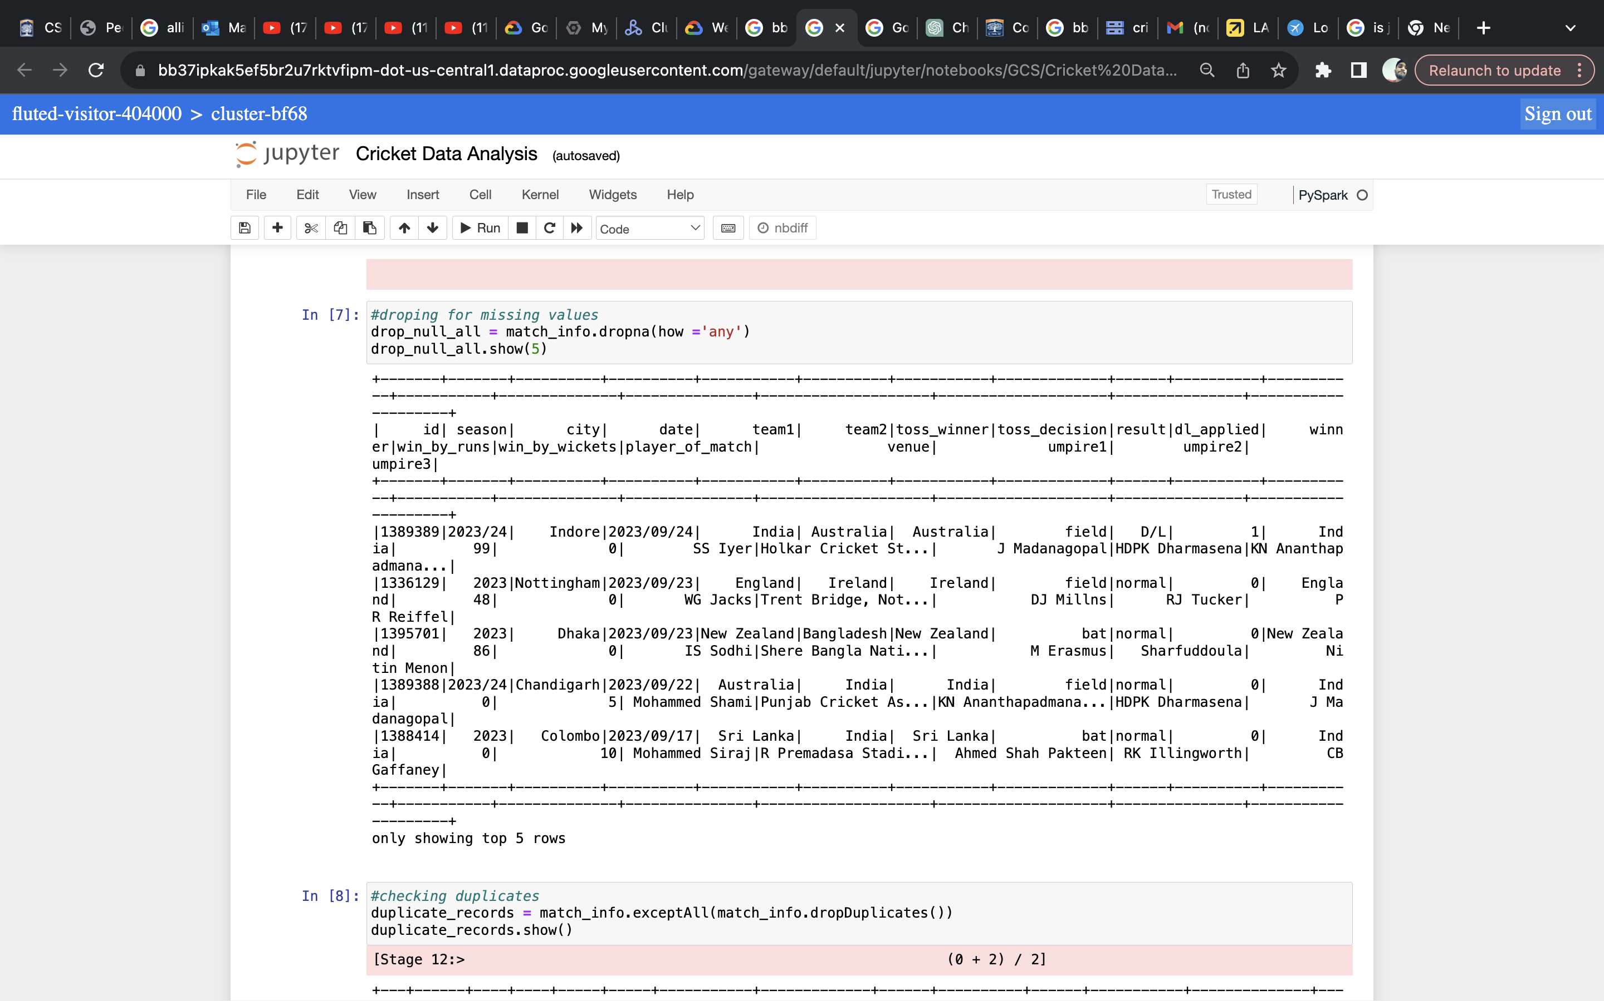
DATA CLEANING

Slide 16
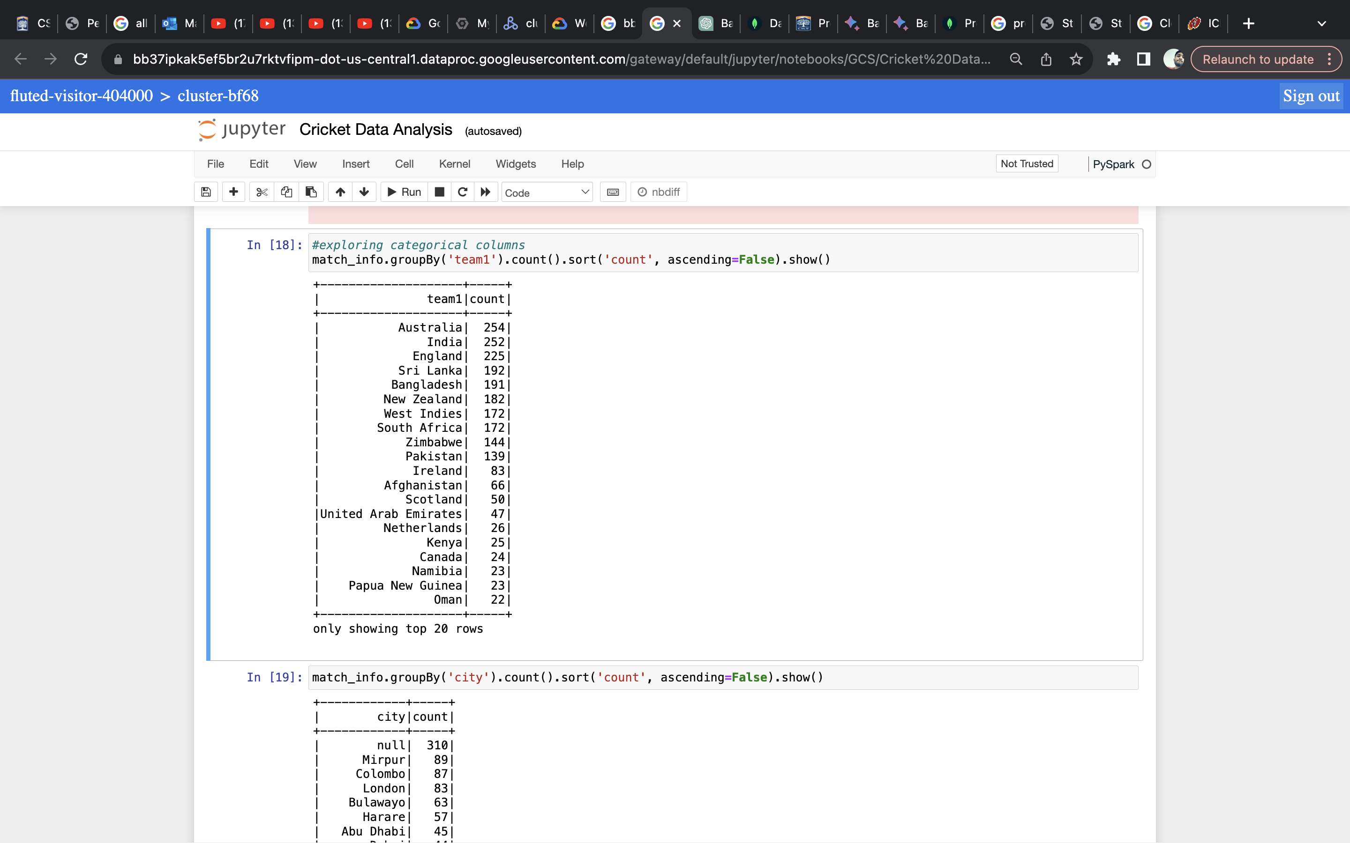
DATA ANALYSIS

Slide 17
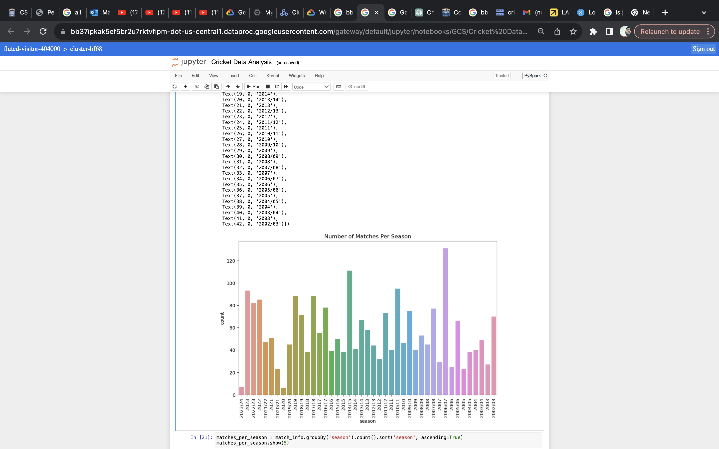
DATA VISUALIZATION

Slide 18
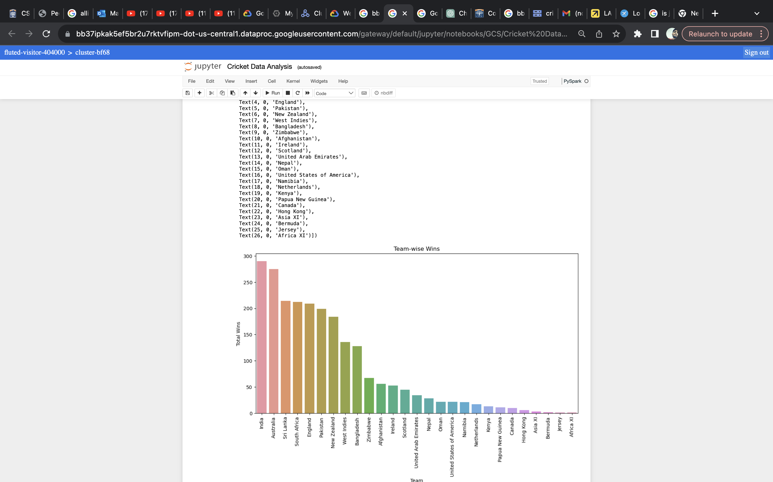
DATA VISUALIZATION

Slide 19
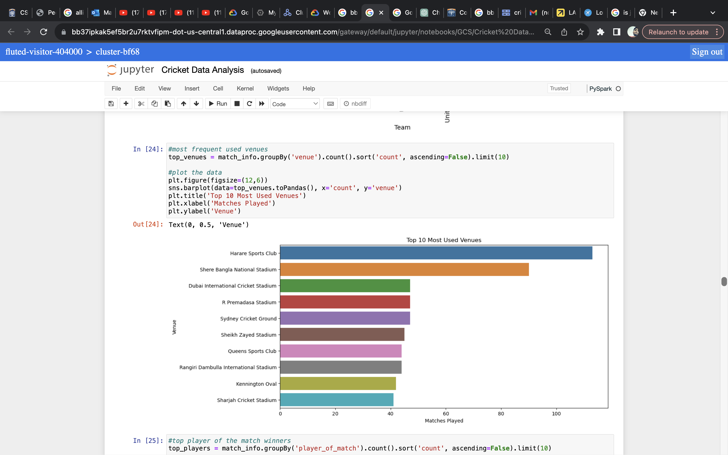
DATA VISUALIZATION

Slide 20
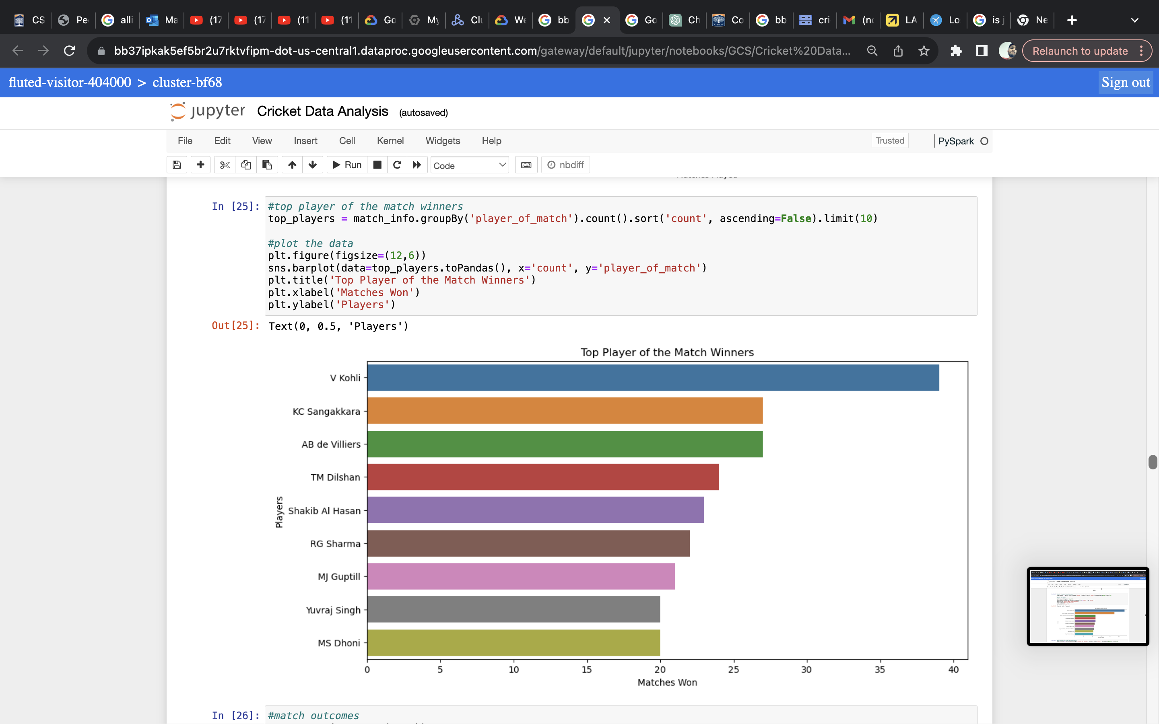
DATA VISUALIZATION

Slide 21
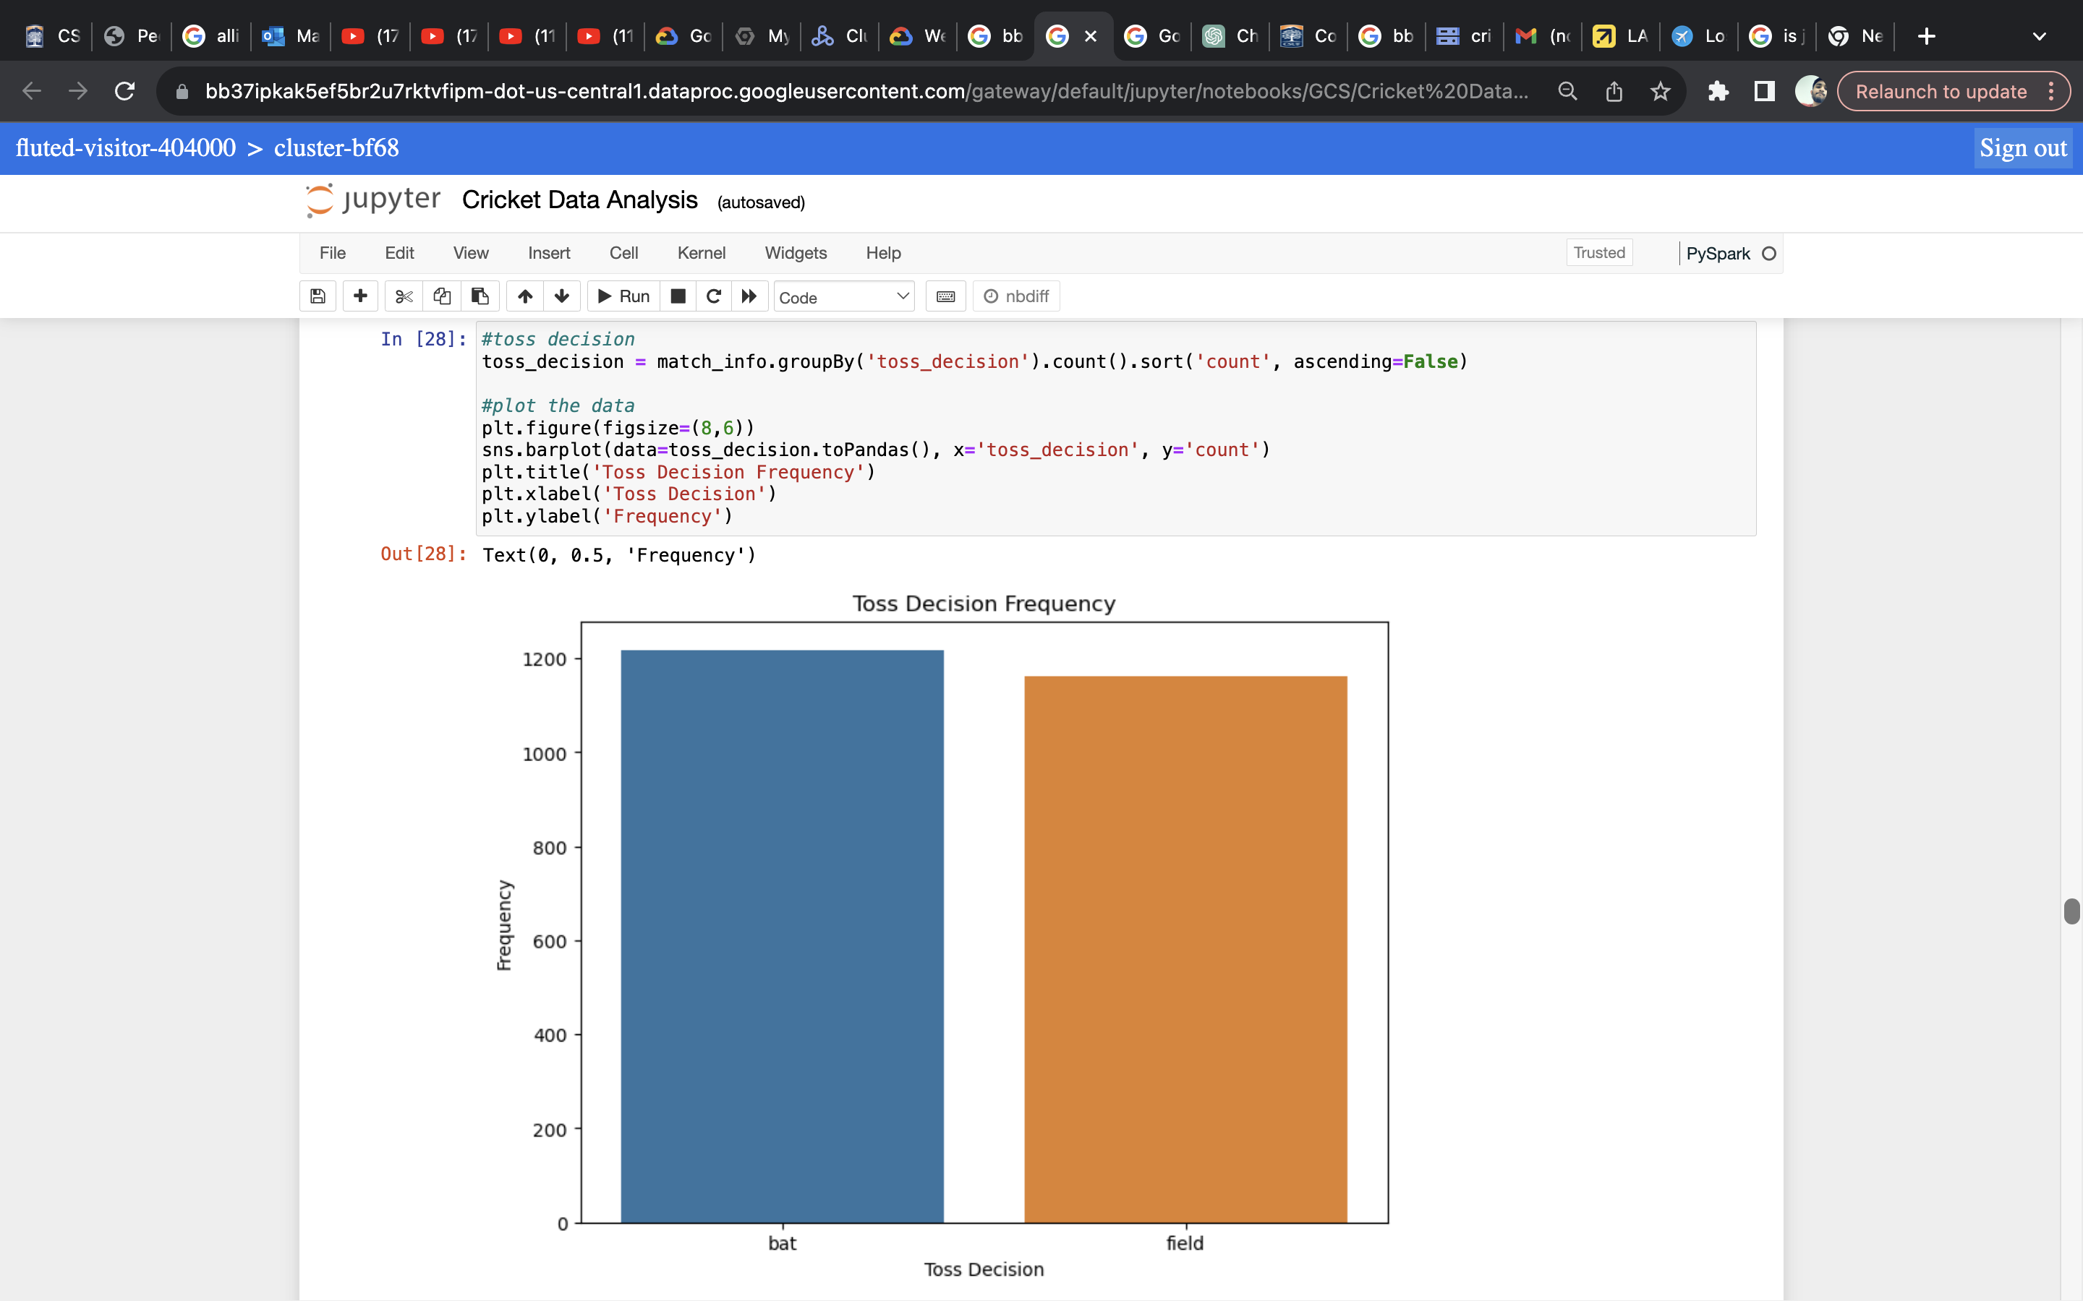
DATA VISUALIZATION

Slide 22
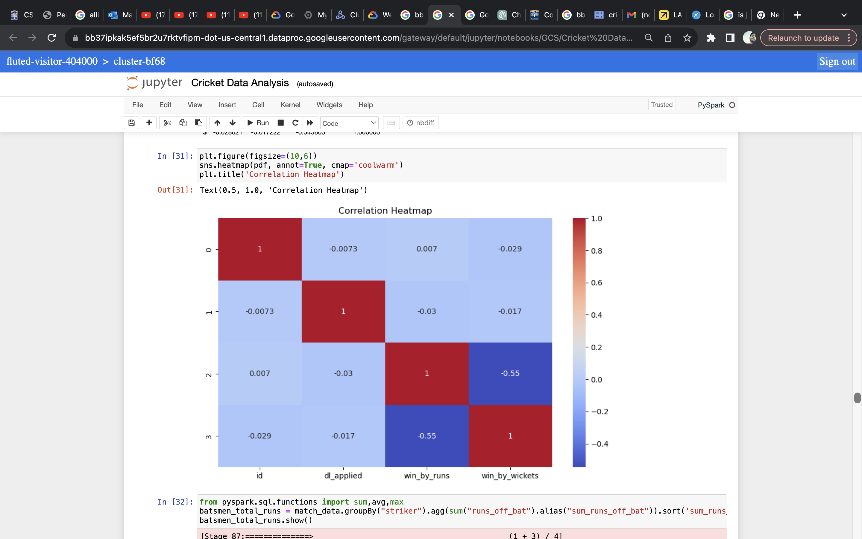
DATA VISUALIZATION

Slide 23
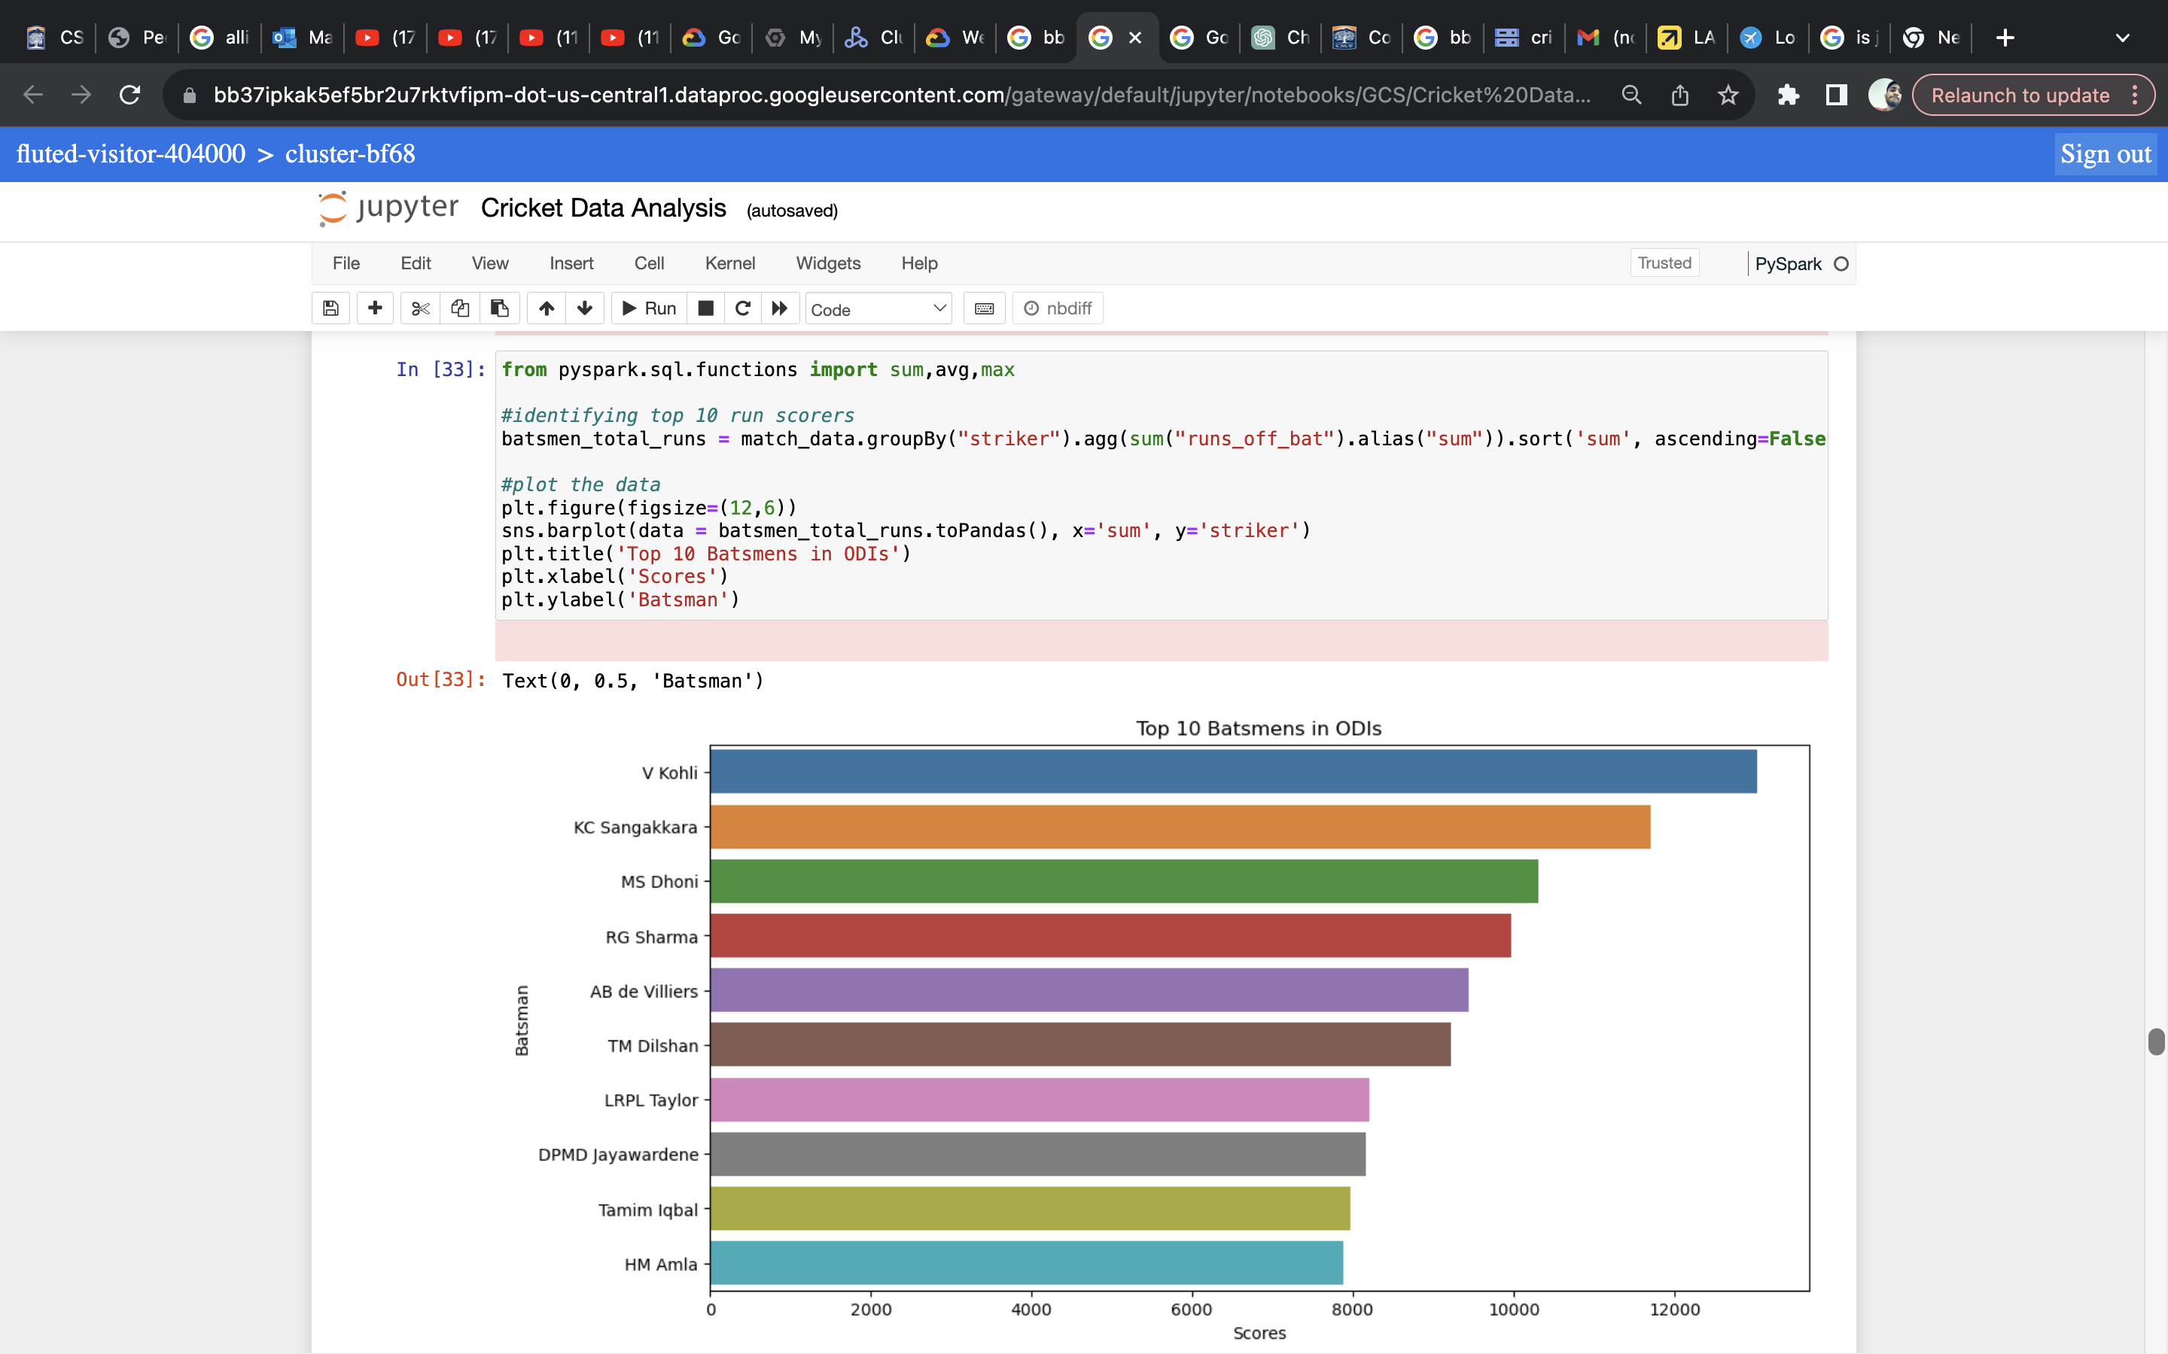
DATA VISUALIZATION

Slide 24
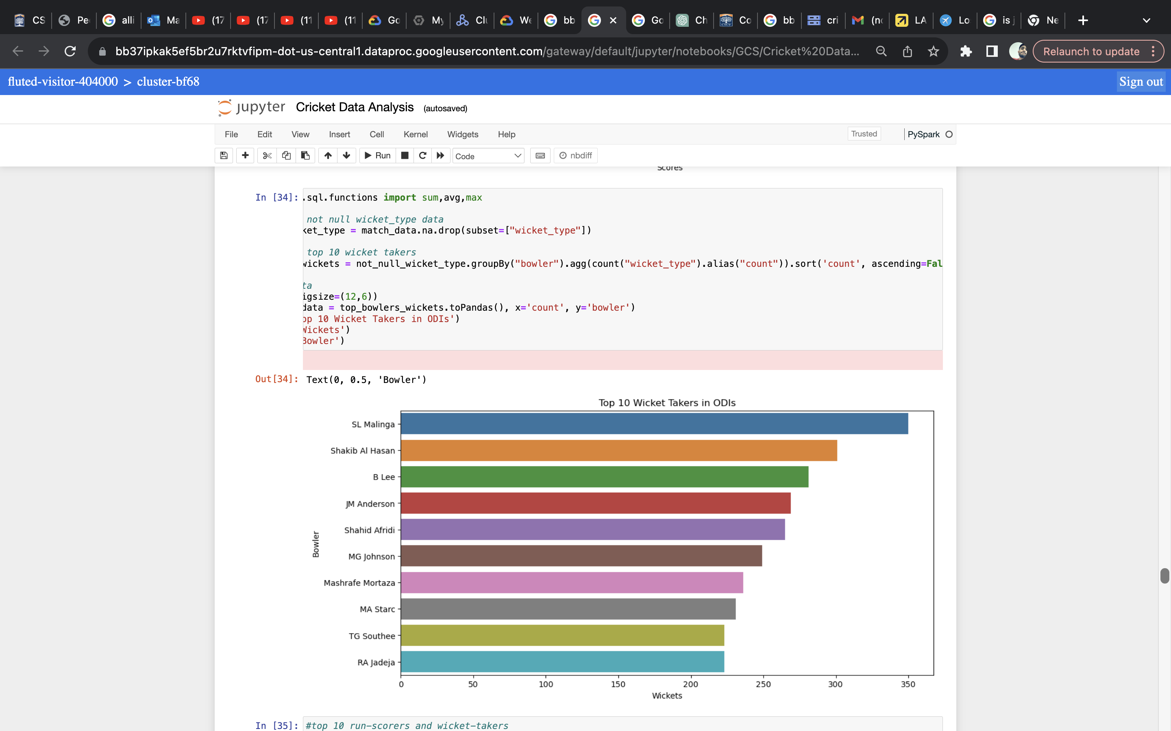
DATA VISUALIZATION

Slide 25
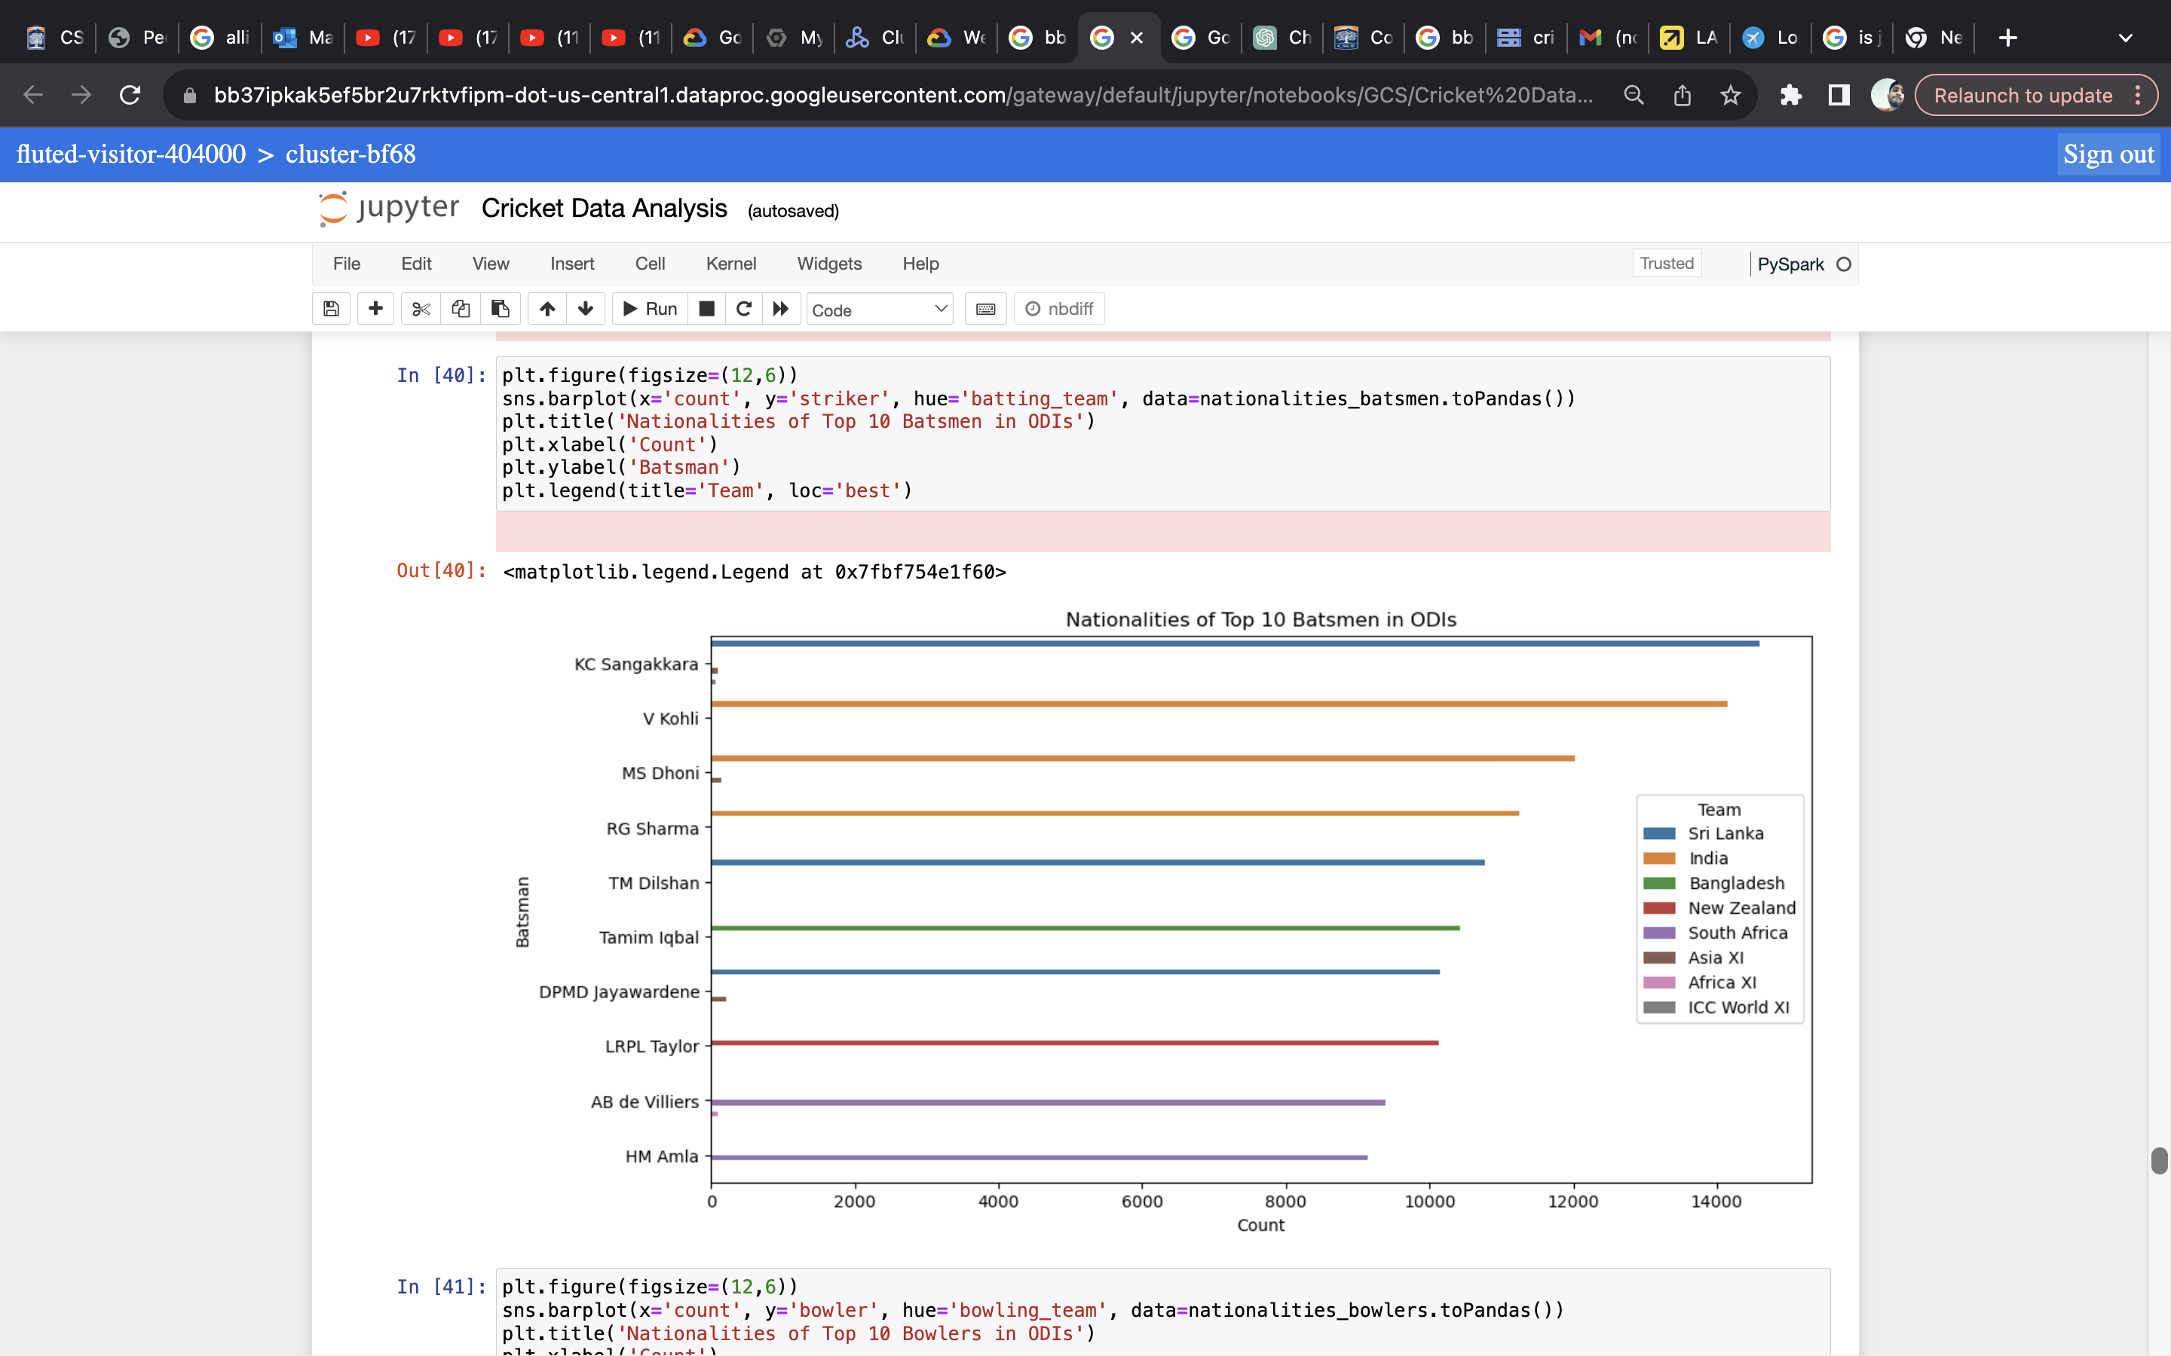
DATA VISUALIZATION

Slide 26
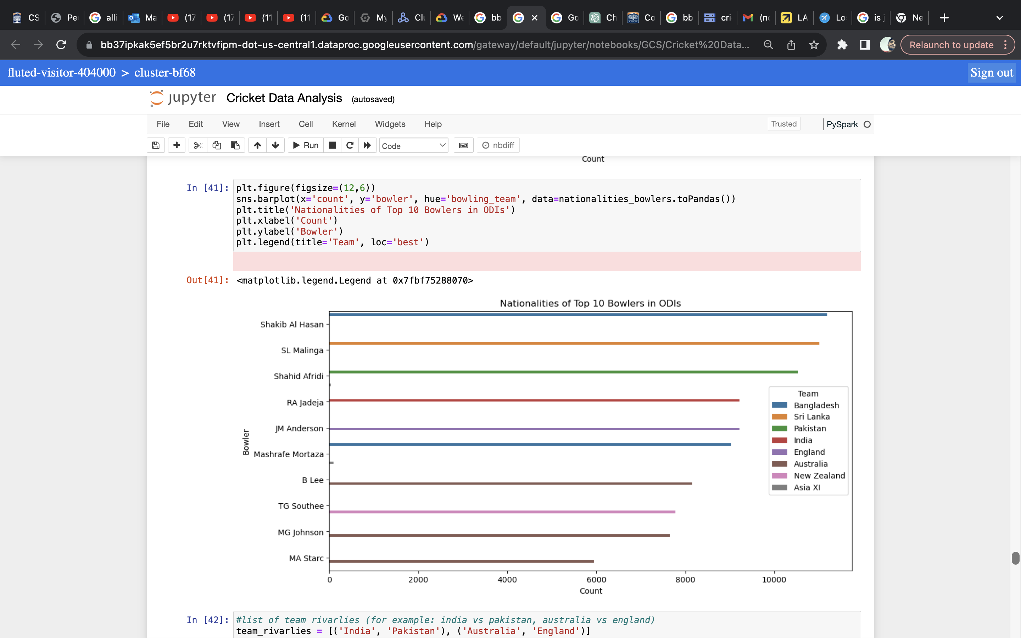
DATA VISUALIZATION

Slide 27
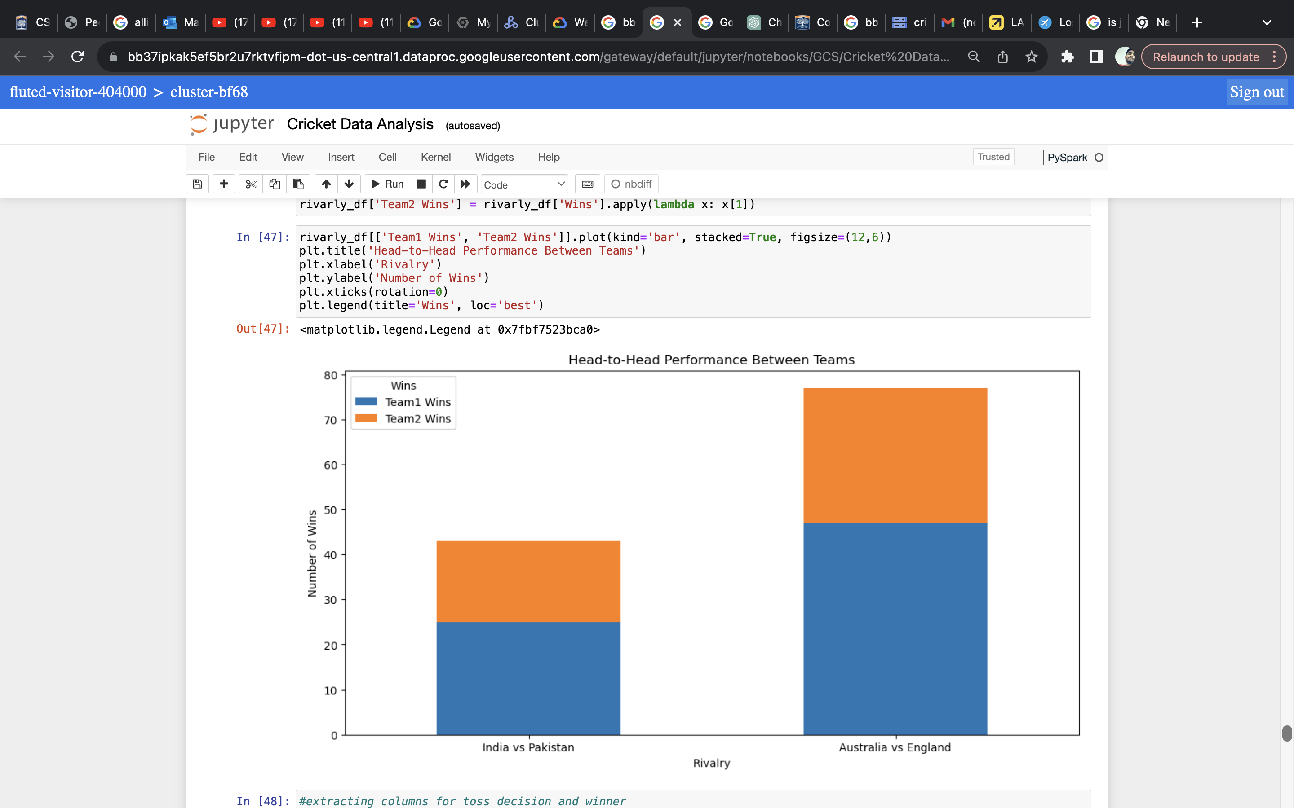
DATA VISUALIZATION

Slide 28
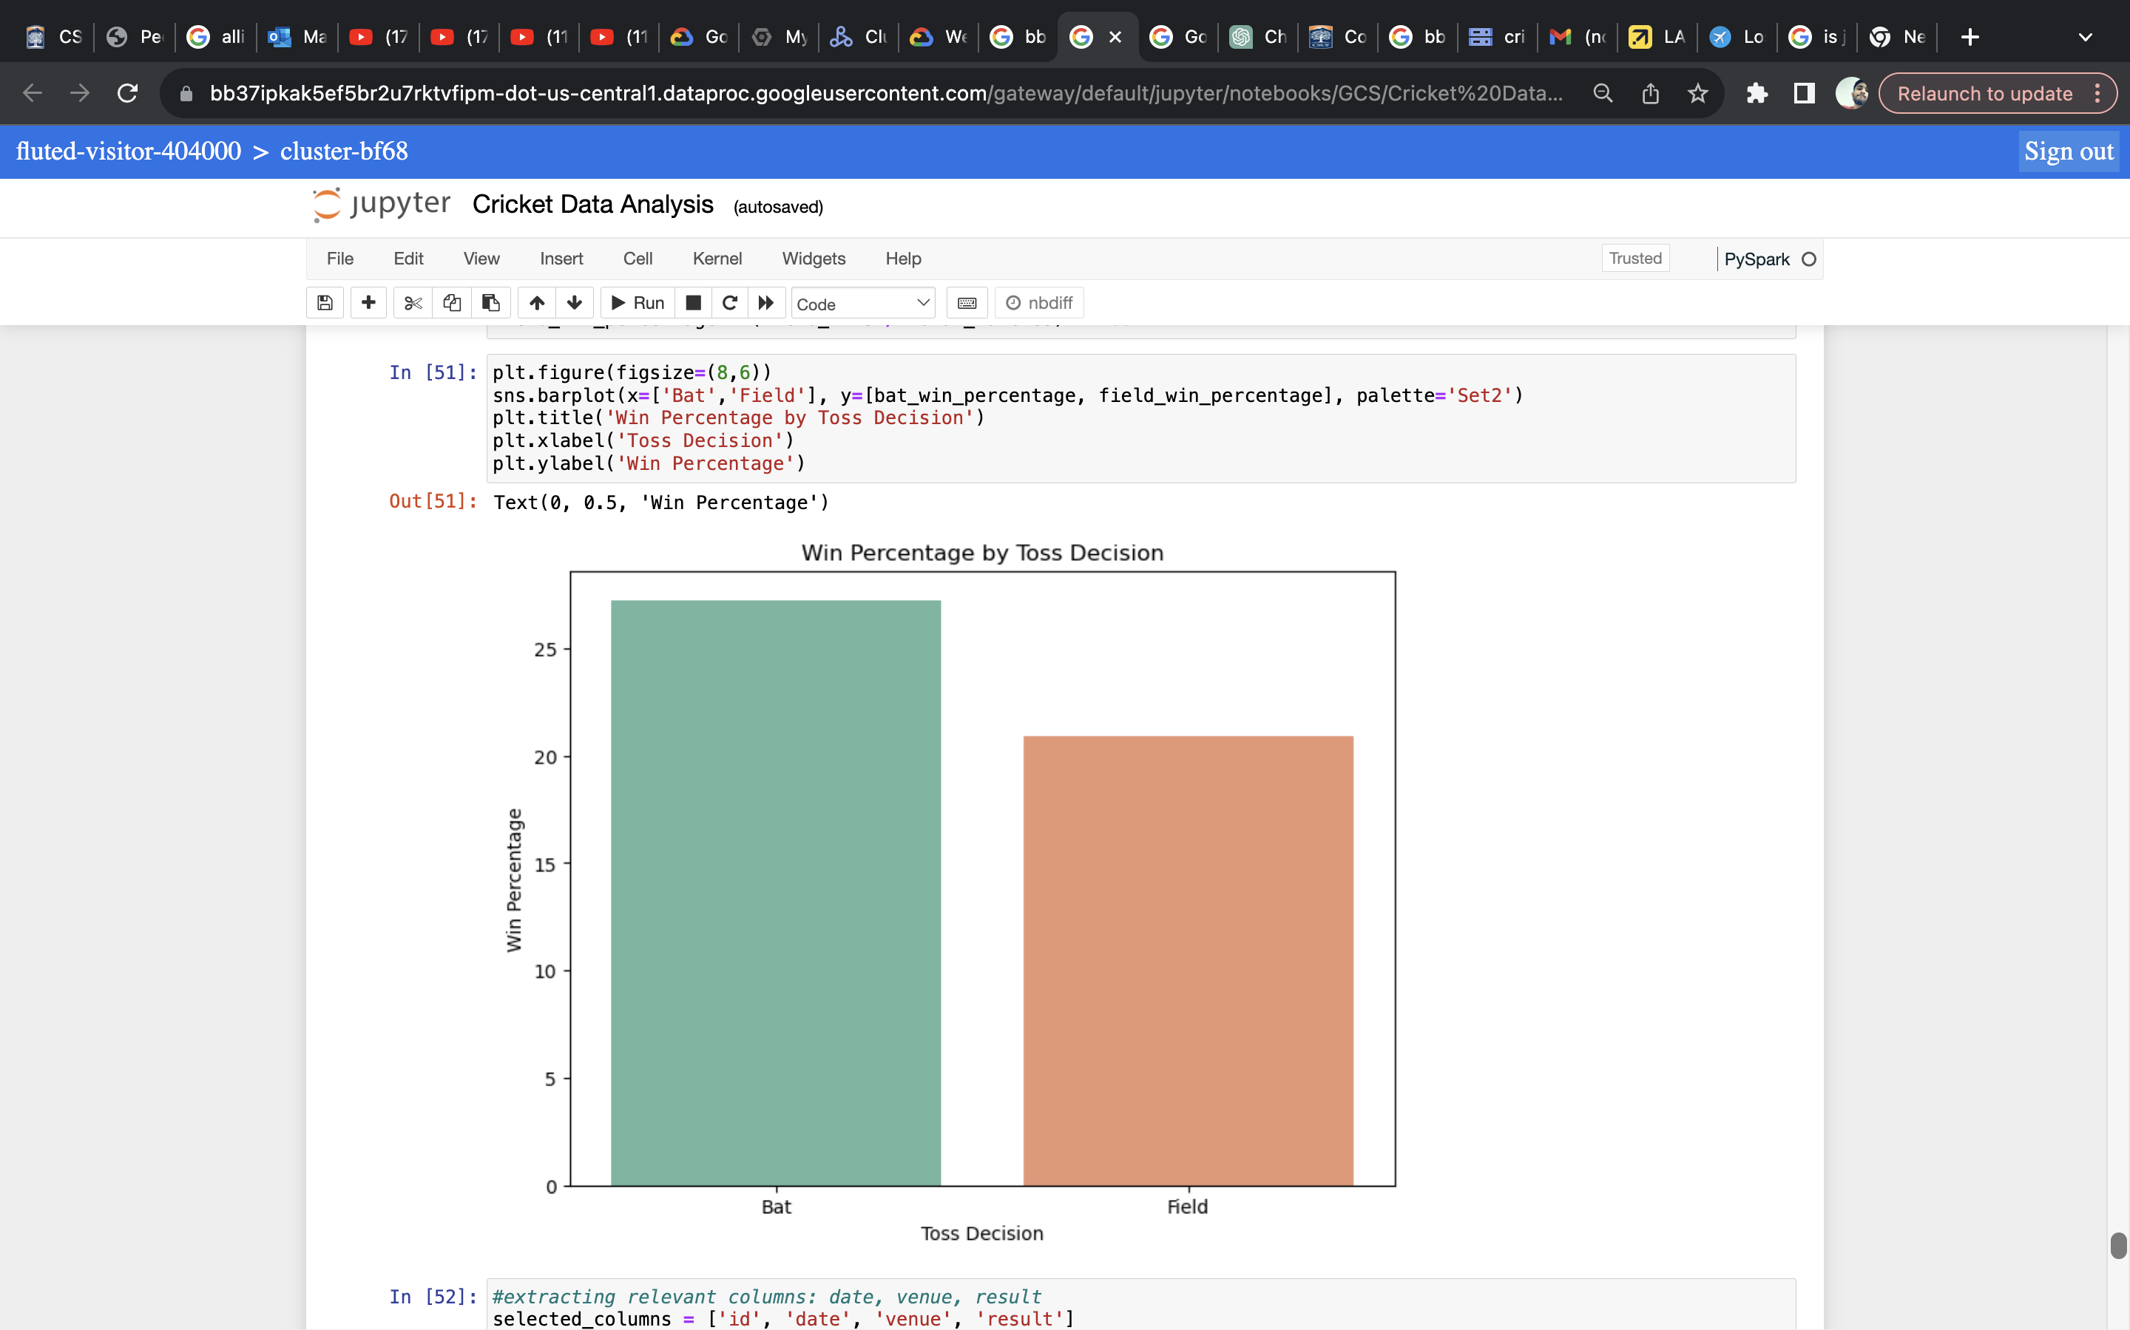
DATA VISUALIZATION

Slide 29
How does big data benefit the cricket industry?
Player Performance Analysis
Team Strategies and Game Planning
Player Scouting
Business and Revenue Data

Slide 30

Thank you

